Slide 1
Int@E
Innovative technologies and education
2nd Managment Meeting at the
HTWK Leipzig
26.-27.08.2019
Role in the Project JOB JO

Slide 2
To start your professional path there are two ways
Open your own business
Start a career in a company

Slide 3
To start your professional path there are two ways
Open your own business

Slide 4
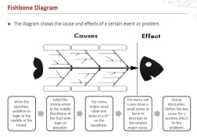
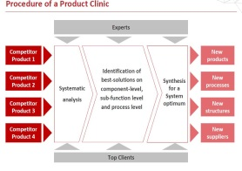
Content of the entrepreneurship training
Problem Analysis

Slide 5
Content of the entrepreneurship training
Problem Analysis
Customer Demand Profile

Slide 6
Content of the entrepreneurship training
Problem Analysis
Customer Demand Profile
Value Proposition

Slide 7
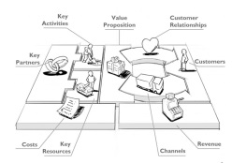
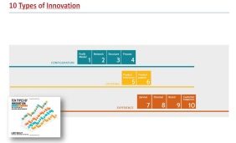
Content of the entrepreneurship training
Problem Analysis
Customer Demand Profile
Value Proposition
Business Model Development

Slide 8
Nine Building Blocks
Source: Osterwalder et al. 2010.

Slide 9
Nine Building Blocks
Source: Osterwalder et al. 2010.

Slide 10
10 Types of Innovation
Source: Keeley, L. et al. 2013.

Slide 11
10 Types of Innovation
Source: Keeley, L. et al. 2013.

Slide 12
10 Types of Innovation
Source: Keeley, L. et al. 2013.

Slide 13
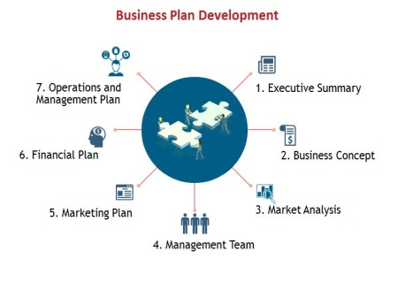
Content of the entrepreneurship training
Problem Analysis
Customer Demand Profile
Value Proposition
Business Model Development
Business Plan Development

Slide 14
Business Plan Development
1. Executive Summary

Slide 15
Business Plan Development
1. Executive Summary
2. Business Concept

Slide 16
Business Plan Development
1. Executive Summary
2. Business Concept
3. Market Analysis

Slide 17
Business Plan Development
1. Executive Summary
2. Business Concept
3. Market Analysis
4. Management Team

Slide 18
Business Plan Development
1. Executive Summary
2. Business Concept
5. Marketing Plan
3. Market Analysis
4. Management Team

Slide 19
Business Plan Development
1. Executive Summary
6. Financial Plan
2. Business Concept
5. Marketing Plan
3. Market Analysis
4. Management Team

Slide 20
Business Plan Development
7. Operations and Management Plan
1. Executive Summary
6. Financial Plan
2. Business Concept
5. Marketing Plan
3. Market Analysis
4. Management Team

Slide 21
To start your professional path there are two ways
Open your own business
Start a career in a company

Slide 22
Interview Training
Types Of Interviews

Slide 23
Interview Training
Types Of Interviews
Preparing for interviews

Slide 24
Interview Training
Types Of Interviews
Preparing for interviews
How to behave in the Interview

Slide 25
Interview Training
Types Of Interviews
Preparing for interviews
How to behave in the Interview
Questions to expect

Slide 26
Successful Workplace Communication

Slide 27
Successful Workplace Communication
The Communication Process – Basic Model

Slide 28
Successful Workplace Communication
Understanding Vs. Misunderstanding
The Communication Process – Basic Model
Factors
Barriers
Overcoming Barriers

Slide 29
Successful Workplace Communication
5 W’s Method
Understanding Vs. Misunderstanding
The Communication Process – Basic Model
Who?
What?
Where?
When?
How?
Factors
Barriers
Overcoming Barriers

Slide 30
Successful Workplace Communication
Developing a Network at Work
5 W’s Method
Understanding Vs. Misunderstanding
The Communication Process – Basic Model
Who?
What?
Where?
When?
How?
Factors
Barriers
Overcoming Barriers

Slide 31
Successful Workplace Communication
4 C’s Method for
Developing a Network at Work
5 W’s Method
Understanding Vs. Misunderstanding
The Communication Process – Basic Model
Consistency
Clarity
Compromise
Confidence
Who?
What?
Where?
When?
How?
Factors
Barriers
Overcoming Barriers

Slide 32
Many thanks for your attention

